Slide 1
GREAT OUTDOORS
Sarthak Lav
Ankush Agrawal
Madhuri
Saurav Maji
Shreyash Pandey
Team A

Slide 2
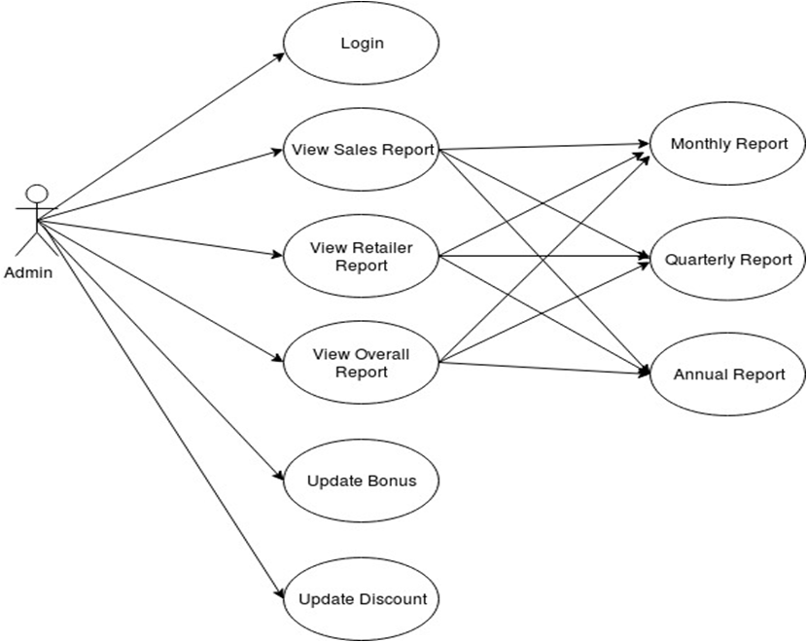
Use Case Diagram: Admin

Slide 3
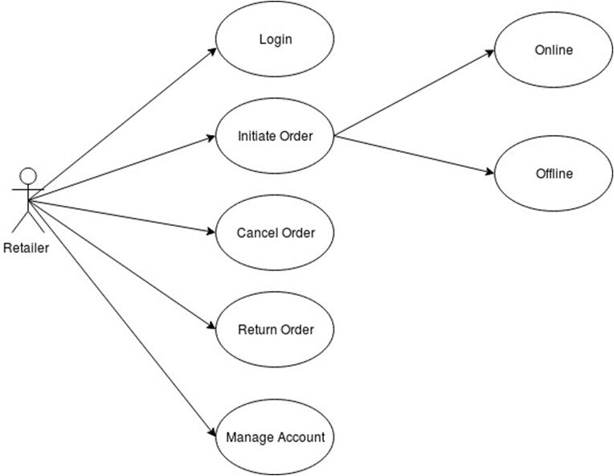
Use Case Diagram: Retailer

Slide 4
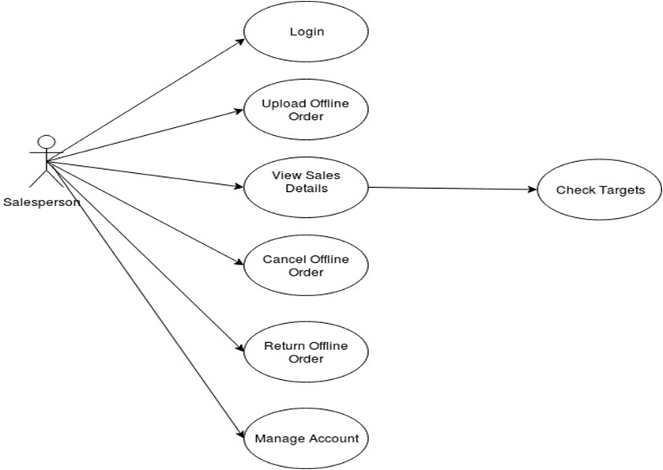
Use Case Diagram: Sales Person

Slide 5
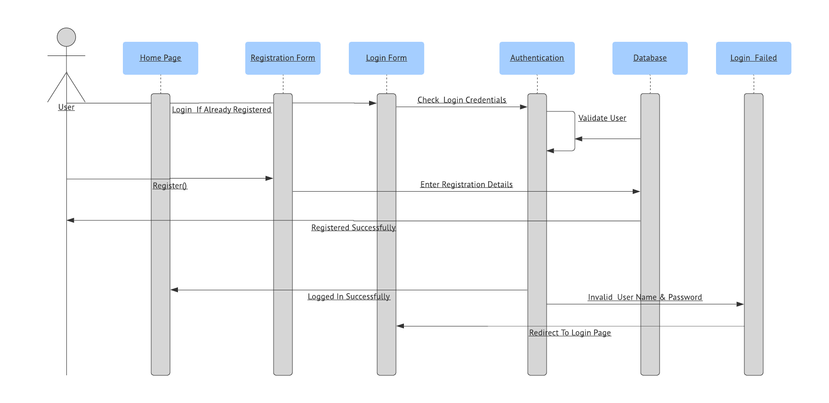
Sequence Diagram: Login

Slide 6
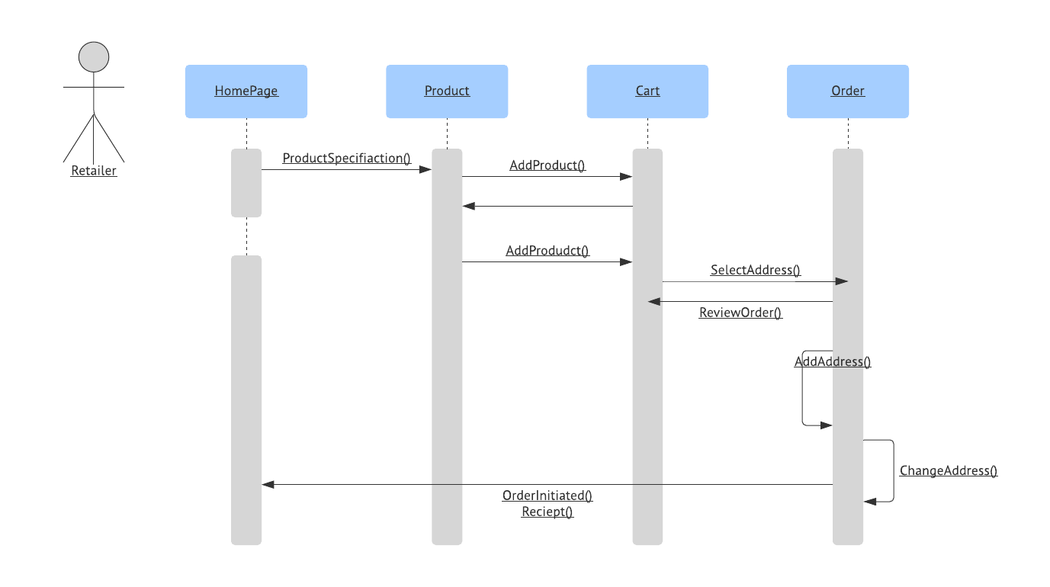
Sequence Diagram: Initiate Order

Slide 7
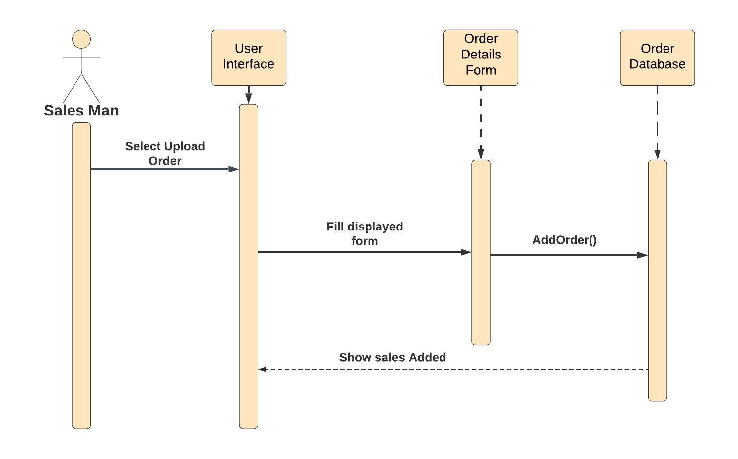
Sequence Diagram for Salesman to upload offline orders :

Slide 8
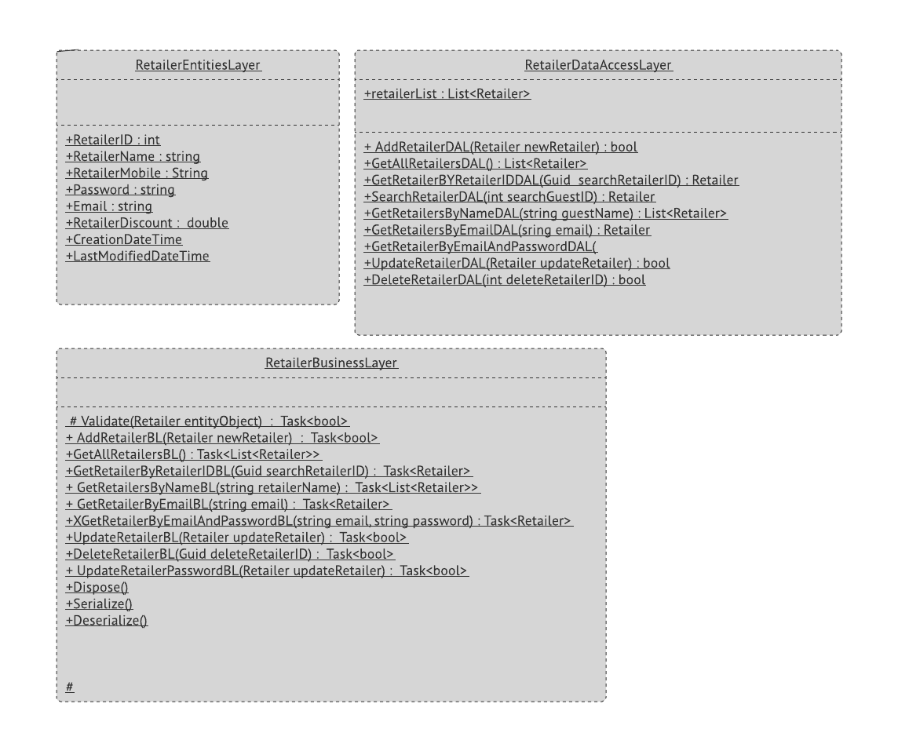
Class Diagram : Retailer

Slide 9
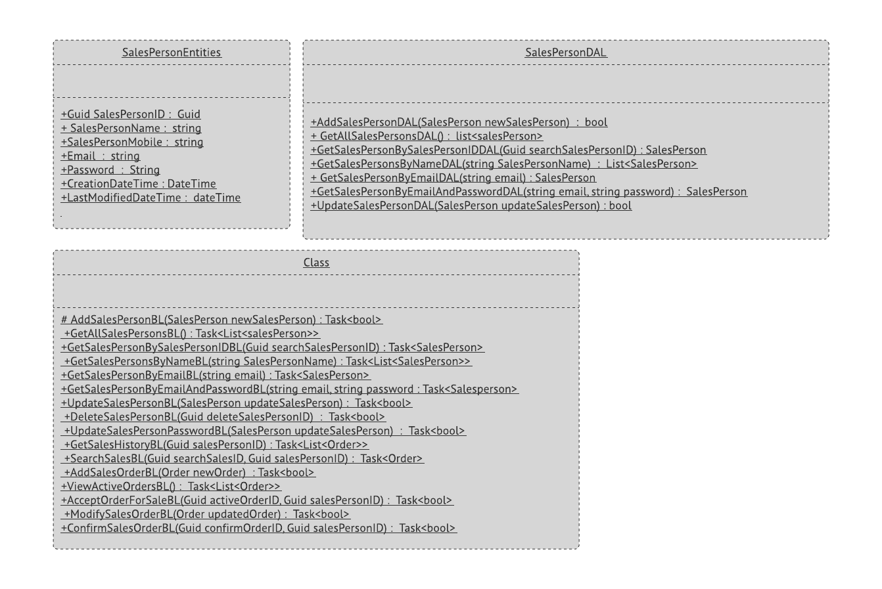
Class Diagram : SalesPerson

Slide 10
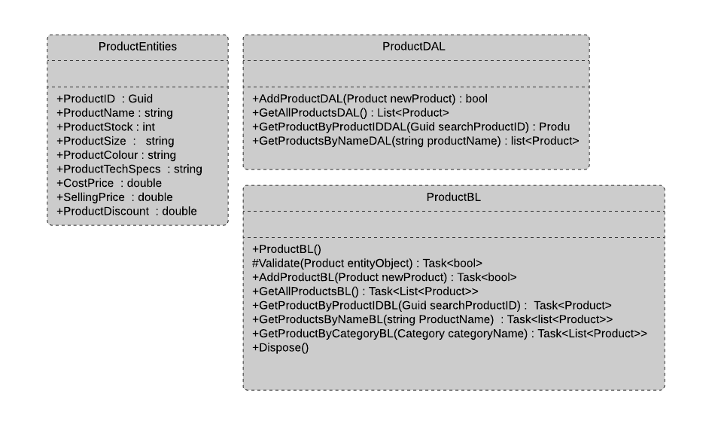
Class Diagram : Product

Slide 11
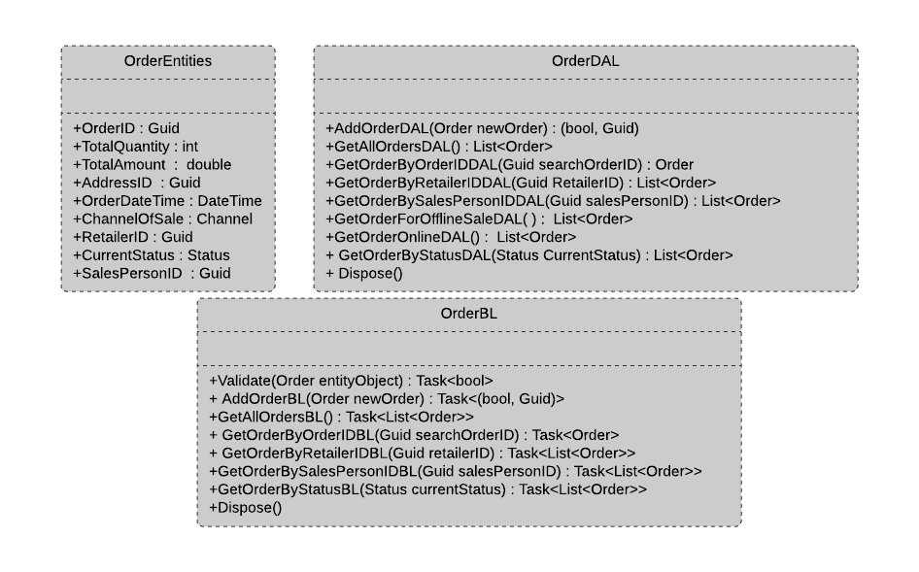
Class Diagram : Order

Slide 12
Thank You

